Slide 1
Telemedicine - Basics
Dr S B Gogia
Dr Sunil Shroff

Slide 2

Conflict of Interest Statement
Name (Dr) | Affiliation(s) | Conflicts
Sunil Shroff | President – Tamil Nadu TSI Editorial Director, www.medindia.net Trustee – MOHAN Foundation | <None>
Shashi Gogia | TSI, DHIndia (Director), SATHI (President), IAHSI, IMIA (Chairperson Telehealth WG), Editor of Book “Fundamentals of Telemedicine and Telehealth” | <None>

Slide 3
Disclaimer
We strive to maintain the best quality and timeliness of the deliverables, however, these documents do not form a product or service agreement, and there is no service level agreement provided. All collaterals and materials are provided as-is on a best effort basis only. While due diligence and a stringent review process have been followed in producing these documents and artifacts, there may be inadvertent errors of omission or commission that have slipped our process. These offerings are provided without any warranty or liability. The users agree to indemnify the administrators and maintainers of this document, the authors, the Telemedicine Society of India (https://tsi.org.in), the contributors and other associates or volunteers against any direct or indirect damages resulting from the information contained herein. The view expressed by individual contributors need not necessarily reflect the views or opinions of the Telemedicine Society of India, the reviewers and maintainers of these repositories, documents and artifacts.
Users are expected to ascertain the validity of the content against the latest guidelines published by the MoHFW and other departments of the Government of India and respective State Governments. https://www.mohfw.gov.in/pdf/Telemedicine.pdf
This material is licensed under "Creative Commons Attribution-ShareAlike 2.5 India". We do NOT guarantee any personal data protection or privacy rights adherence. Users and contributors, alike, are advised to diligently avoid submissions of any information they do not wish to make public. Disputes are subject to the jurisdiction of the courts in New Delhi, India only.

Slide 4







Attribution-ShareAlike 2.5 India
(CC BY-SA 2.5 IN)
You are free to:
Share — copy and redistribute the material in any medium or format
Adapt — remix, transform, and build upon the material for any purpose, even commercially.
The licensor cannot revoke these freedoms as long as you follow the license terms. Under the following terms:
Attribution — You must give appropriate credit, provide a link to the license, and indicate if changes were made. You may do so in any reasonable manner, but not in any way that suggests the licensor endorses you or your use.
ShareAlike — If you remix, transform, or build upon the material, you must distribute your contributions under the same license as the original.
No additional restrictions — You may not apply legal terms or technological measures that legally restrict others from doing anything the license permits.
This is a human-readable summary of (and not a substitute for) the license available at https://creativecommons.org/licenses/by-sa/2.5/in/legalcode
Notices:
You do not have to comply with the license for elements of the material in the public domain or where your use is permitted by an applicable exception or limitation.
No warranties are given. The license may not give you all of the permissions necessary for your intended use. For example, other rights such as publicity, privacy, or moral rights may limit how you use the material.
Disclaimer:
This deed highlights only some of the key features and terms of the actual license. It is not a license and has no legal value. You should carefully review all of the terms and conditions of the actual license before using the licensed material.
Appropriate credit:
If supplied, you must provide a link to the creator and attribution parties, a copyright notice, a license notice, a disclaimer notice, and a link to the material.
Indicate if changes were made:
You must indicate if you modified the material and retain an indication of previous modifications.
You may need to get additional permissions before using the material as you intend.
Based after https://creativecommons.org/licenses/by-sa/2.5/in/

Slide 5
Contents
Scope of telemedicine and telehealth
Different tools for practice
Opportunities and Challenges
Proper E-Consent and E-Prescriptions
Some day to day Issues
A live example

Slide 6
Recent changes
What has Changed
What is New
Illness care → Wellness support
The need for prevention
What is fascinating → What works
Tele-Medicine Telehealth
Better and Faster Connectivity
PC → Mobile
Artificial Intelligence
Ayushman Bharat
ePHCs and Wellness centres
Training for Telemedicine & Telehealth
Internet of Things (IoT)
Drones

Slide 7
Telemedicine had Issues --continued
Issue(s)
What has changed
Technology
Legal (including Licensing) & Ethics
Better Connectivity
4G, Fibreoptic & Broadband✓
Better tools ✓
Mobile does almost everything
Release of Telemedicine Practice Guidelines

Slide 8
Telemedicine had Issues in the past
Issue(s)
What has changed
General & perceived objections
Standards
“I have not touched the patient!”
Assurance that you will not be charged
Now it is patient driven
EHR Standards (SNOMED CDA/FHIR/ICD etc)
Terminology and Language support ✓
Social distancing
Empathy is possible online!

Slide 9
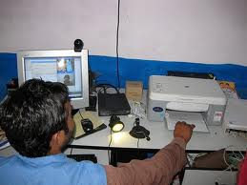
Tele Health
or Digital Communication for Health
Use of information and communications technologies (ICTs) to deliver health services and transmit health information over both long and short distances
Engages care recipients, health professionals or educators.
About transmitting voice, data, images and information rather than moving
Encompasses treatment, preventive (educational) and curative aspects of healthcare services for recipients

Slide 10
Case for Telemedicine/ Telehealth
Increases your access to care
No transportation time or costs
Improves quality of care delivery
No need to take time off of work
Reduces overall healthcare costs, efficiency and quality
Enhances traditional face-to-face medicine
Improves patient engagement and satisfaction
Less time in waiting room;
remote monitoring

Slide 11
Case for Telemedicine /Telehealth --cont
Improves provider satisfaction
reduces patient no-shows
Better clinical workflows
increases practice efficiency & revenue;
Reduces practice over-head
Doctor, as well as patient both can continue family responsibilities
Childcare and elderly care
Disasters, Pandemics/War/ Space
Less chance of catching COVID 19

Slide 12
Classification of Telemedicine
Real time
Tele-monitoring
Store and Forward
Store and Forward (Asynchronous)
SMS/WhatsApp/Email
Electronic Health Record
Real-time (Synchronous)
Telephone
Video-consultation
Hybrid (both of above)
Specialized Apps (Android /IoS/PC)
Browser based (Web Apps)
mHealth

Slide 13
Store & Forward process – Convert record to electronic format
Medical Record consists of
History
Examination
Investigations
Lab
X Ray/USG/CT/MR
Histo/Cytopath
Others
Invasive Procedures
Digital Component
Text
Images
Sounds
Video Clips
Wave Forms
Video Conference
Very High Bandwidth
Low Bandwidth
High Bandwidth

Slide 14
Classification as per TSG
Patient to doctor -here restrictions and ethics apply more strongly

Slide 15
Telemedicine has various streams
Home Healthcare
Devices (Home based monitoring), IoT (Internet of Things)
Patient to Doctor
Web Opinions/ Email / SMS/ Whats App/ Phone/VC
From Nurse/ASHA to Doctor
Project Based/ One to one
Between Doctors /Specialists
Discussion Groups/ Whats App/ Phone
Satellite Centres
Project based /Medical Tourism (done by Hospital Groups)

Slide 16
Telemedicine is preferred choice for
Tele-triage for Emergencies /COVID
Chronic diseases
Revisits
Especially if you can trace old record ( have an EMR)
Follow up after surgery
Those without means to travel
When time is of essence
Devices available

Slide 17
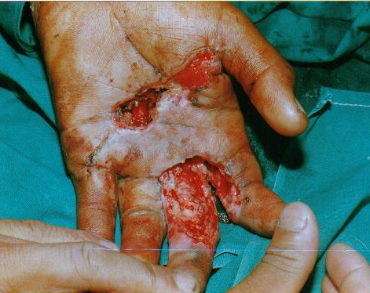
An image is better than a thousand words! A picture can tell a story
Photographs
Patient
Examination findings (e.g. slit lamp)
Gross Pathology & Slides
X Rays/MRI/CT
Real time Ultrasound/Angio
Video clips

Slide 18
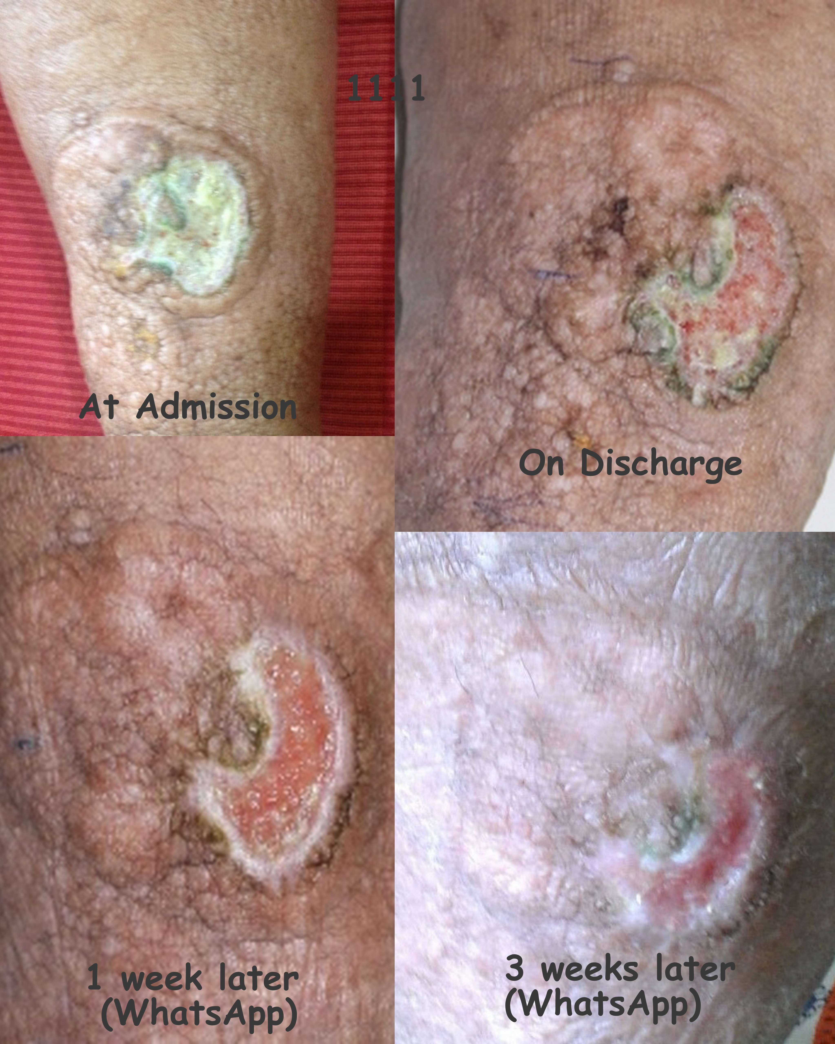
Further classification and Relative Value
Specialty | Role
Current Pandemic | Essential
Wound care | Very high
Dermatology | Very high
Ophthalmology | High
Psychiatry | High
Intensive care | Moderately high
Emergency care | Moderately high
Rehabilitation | Moderate
Pediatrics | Moderate
Orthopedics | Moderately low
Neurology* | Moderately low
Care Process Consult/Monitor/ appointment/data
Specialty Radiology/Plastic Surgery/Cardiology/ Pathology/etc
Connectivity and other modalities Digital skill levels, Applications, Operators
Those using Images/sound and can use video conference. High role in Chronic diseases and home care, procedures are more difficult

Slide 19
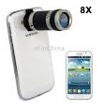
mHealth
Basic/Simple mobile phones (cheap)
Enable health workers or patients in low connectivity areas
No need for land-lines
Work through Internet (’Cloud’ Services)
Smart phones (higher cost)
Like a hand-held computer plus more: combines voice, text, and data with mobility, as well as extra sensors like GPS, inbuilt Camera, Movement sensor, etc
Comfort level with Phones is far higher
Disadvantage: small screens.
Tablets (e.g., iPads) Bigger Screen, portable but relatively costly
“I don’t prescribe medicine anymore, I prescribe apps” –Dr. Eric Topol
Cardiologist in San Diego

Slide 20
Desktop Computer (Tablet if mobility required)
Big screen
Relaxed atmosphere to work/ can be made sound proof
Can use for
(a) dedicated App or
(b) Electronic Health Record System
Many add on peripherals e.g. :
A dermascope for a dermatologist
TeleECG and Tele-stethoscope for a cardiologist

Slide 21
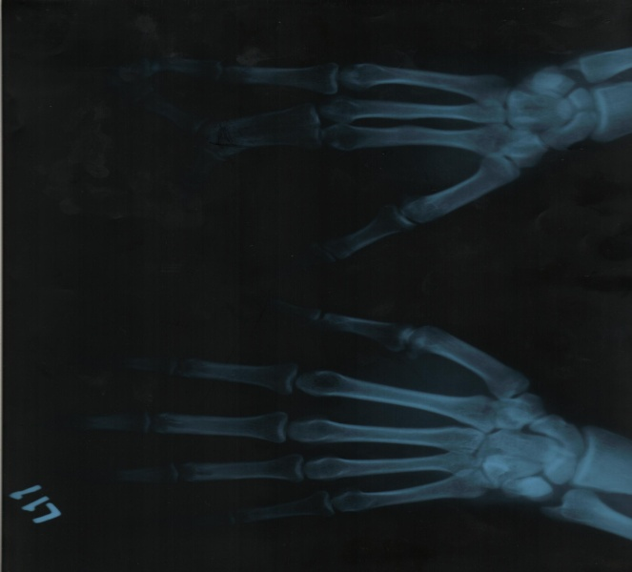
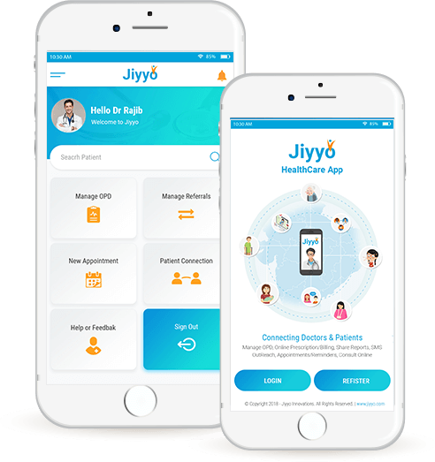
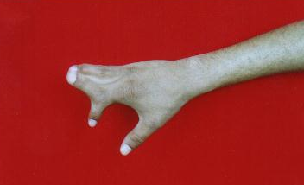
Apps have inbuilt Processes
E-Login
E-Register
E-History (facilitates review and referral)
Upload documents, images and videos (Reports, photos, X rays, USG etc)
E-Consent
E-payment
E-prescription processes

Slide 22
Some more tools- mHealth/ computer Patient safety and privacy a concern
Social Media (WhatsApp, Skype, TikTok, Google Hangout, etc)
Synchronous as well as asynchronous
Possibility of one to one or one to many connections
Good for providing general information and counselling
To advertise your skills
Make sure not to break MCI Ethics code!
Online meetings (Skype, Webex, Zoom, Google Hangout, etc)
Can double up as health app but
No links with EHR /No online prescriptions!
Data often resides outside India
Safer paid platforms are expensive

Slide 23
Contra-indications for Telemedicine
Unsure of consent
Emergencies
No local support
Requires procedure
No connectivity

Slide 24
Challenges of Telemedicine
Problems affecting decisions
Affect on medical personnel
Misinformation
Auto-typing on mobile can cause wrong words
Possibility of misinterpretation
Less-information
Over information
Can be diversionary
Safety and Security
Patient Privacy
Behavior Change
Less bonding = Less Reliability
Interpersonal relationships
Fraud
Can get calls at inconvenient times!

Slide 25
Video consultation: special considerations
NEED TO
CONSTRAINTS
DRESS UP
Even in the middle of the night
AVOID UNPLEASANT SOUNDS
bathroom
BE ON TIME
People may not even know if you are coming or not
FOR INTRODUCTIONS
Need for respect and curtesy
Your time may not match that of others
But the doctor should decide!
Your surroundings are revealed
Technological Issues
Proper equipment required
ECHO /feedback/background noise
Many speak may speak at the same time
https://dhindia.org/2020/03/27/simple-dos-and-donts-about-using-video-conferencing-for-teleconsultation/

Slide 26
e-Prescriptions Obtain e-consent, if required, as per the March 2020 Telemedicine Practice Guidelines ( MCI
Basic or Feature Phone: (low bandwidth)
Dictate directly to the patient or a chemist the detailed drug information, check understanding by asking the patient or pharmacist to repeat; or
Send e-prescription by SMS, WhatsApp or email etc, to pharmacy
Some feature phones can accommodate apps
Smart Phone without App: (High bandwidth)
Take a photograph of prescription on your letterhead, in prescribed e-format, sign it and send as above
Through Apps (Mobile or Computer)
Allows templates and clean crisp ready to print e-prescription ( also direct viewing in patients or chemists mobile) and can includes a signature. E-Consent processes is generally inbuilt

Slide 27
1. (O) Commonly used ‘over-the-counter’ medications such as Paracetamol, ORS packets, Antacids etc. Some emergency medicines may be notified to be included in this group from time to time. (HCQS??)
2. (A) Medications when a clearcut diagnosis is possible through VC such as antifungals for Tinea, Ciprofloxacillin eye drops for Conjunctivitis etc. and Re-fills for chronic diseases (Diabetes, Hypertension, Asthma etc)
3. (B) Add-on’ medications used to optimize an existing condition. E.g., adding an Ace inhibitor such as Enalapril for uncontrolled BP in a patient already on Atenolol
4. Prohibited For instance, Anti-Cancer drugs; Narcotics such as Morphine, Codeine etc
Never prescribed

Slide 28
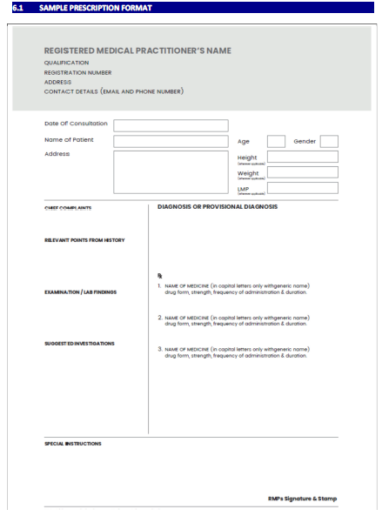
Sample Prescription

Slide 29
How to take and record e-consent? (without App) (Demo possible offline for those interested)
A. Verbally informing the rights and duties to the patient (like in any Bank or credit card call centre) with recording of the transaction .
B. (SMS or Email) with a mandatory need to reply e.g. "I have read the chances of problems and give consent for the going ahead with this telemedicine session.“
C. Interactive Consent Form by mail or web link which the patient resubmits back after checking clicking at appropriate places

Slide 30
Sample Consent

Slide 31
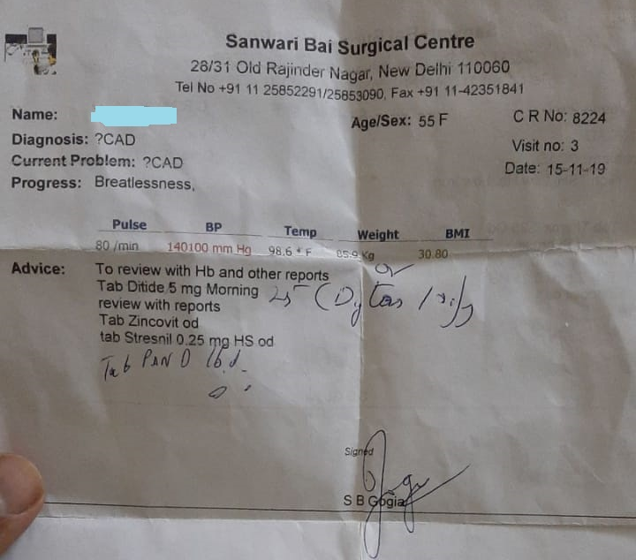
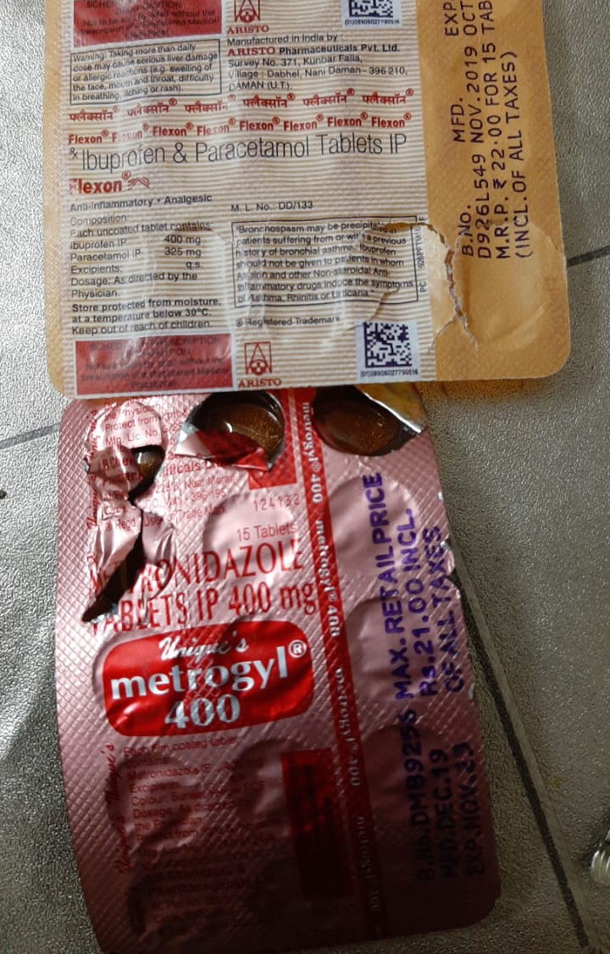
Personal Example case
3rd Apr – on Phone 55yr prev pt
H/O Mid abd pain, Belching, nausea
Desc - only discomfort, no Vomiting
(Qs) Passing motion, no distension
Recent h/o back pain and taking some medicines.
Through WhatsApp her son sends photo of previous prescription and drugs she was taking after showing to another doctor

Slide 32
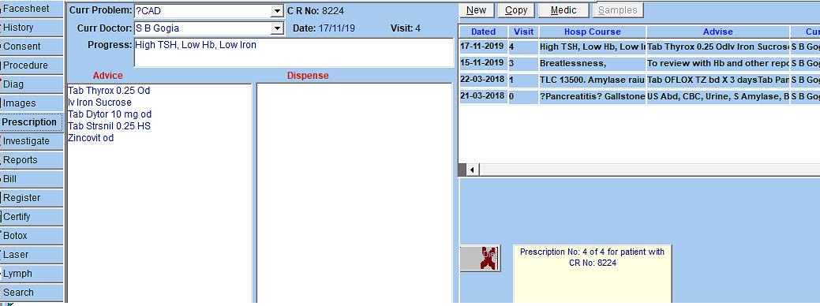
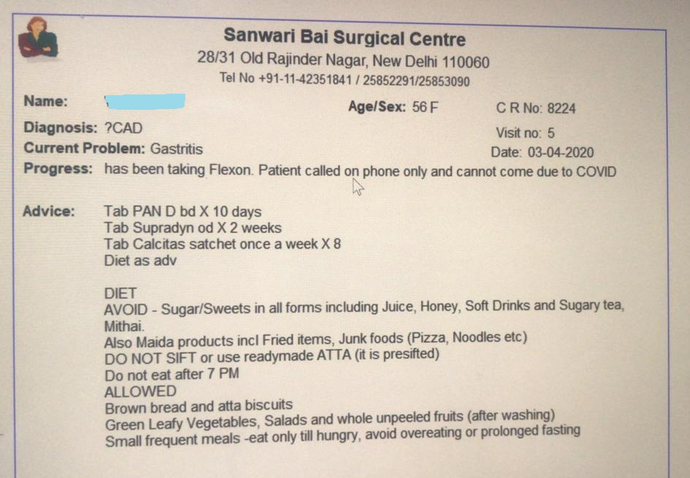
Tentative Diagnosis - Drug induced Gastritis
Further confirmed by checking EMR of patient
Had come with doubt of CAD but found to be gastritis
Assurance given, Prescription made -> Screenshot of Prescription preview sent (no print required)
Told that if she develops vomiting, distension or increase /persistence of pain she can call again or come for Iv drip
Note Consent not required as previous patient, initiated by patient with us having full record and documentation
Also note that the patient name is blanked out for this presentation (Privacy)

Slide 33
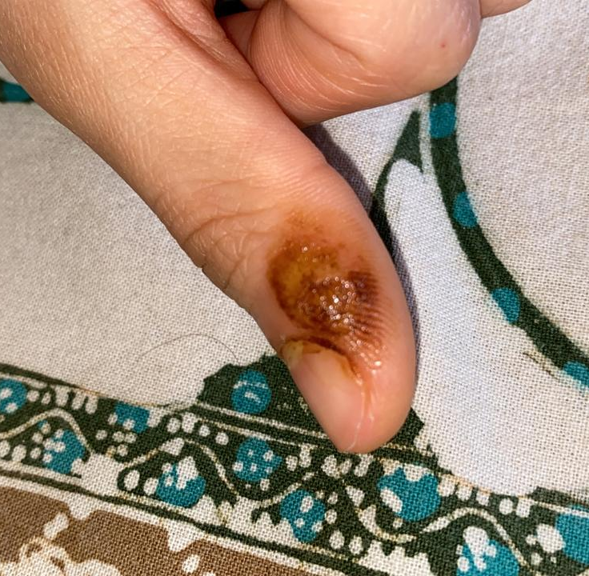
Example 2 (Apr 4th)
20 yr girl under treatment for Warty lesion on the thumb
Had been advised Podophylline with salicylic acid for a few days
Could not come to show because of lockdown continued on her own (3 weeks now)
Diagnosis - Burns due to Podophylline
Advise – Stop Podophylline and start Antibiotic cream
Thank You -
Welcome your questions

